Slide 1
SoliDAIR
General presentation
Date – Speaker‘s name
Organisation

Slide 2
General call information
Call topic: HORIZON-CL4-2022-DIGITAL-EMERGING-02-05 - AI, Data and Robotics for Industry optimisation
Type of Action: HORIZON-IA
Start date: 01/10/2023
Duration: 36 Months
Budget: € 2 988 331,76
Coordinator: Fraunhofer IPA

Slide 3
Ambition and Objectives
Ambition
SoliDAIR brings together 10 manufacturing, technological and research experts to accelerate the uptake of AI and Robotics in European manufacturing, while using Data as an enabler, by co-developing and demonstrating tailored solutions to digitalise and automate visual inspection and physical testing, enable predictive quality control and process optimization for automotive manufacturing, and extrapolating for wider application in similar industries.
Objectives
Objective 1 | Production processes are improved through digitalised & automated quality control for high volume, high rate, and flexible manufacturing
Objective 2 | Adaptable and replicable modules are developed with cutting edge, trustworthy and usable technologies in 3 functional themes: Visual AI, Data & AI, and Robotics & AI
Objective 3 | Competitiveness and sustainability of EU manufacturing companies is increased
Objective 4 | Widespread adoption of European AI, Data & Robotics technologies across EU manufacturing industries is facilitated and boosted to maximise the impact

Slide 4
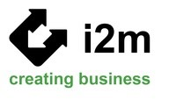
Consortium

Slide 5
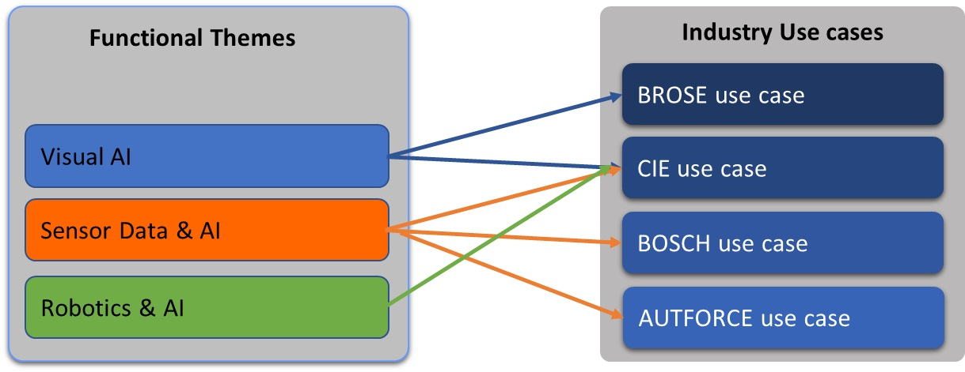
Functional Themes and Use Cases
Functional Themes
Industry Use Cases

Slide 6
Impact
Impact 1 | AI, data and robotics, and automation will be advanced for the optimisation of production processes, to increase competitiveness, improve working conditions, environmental sustainability, and supporting the European Economy using AI, data and robotics technologies.
Impact 2 | Processes to increase competitiveness and supporting the European Economy will be optimized.
Impact 3 | Processes to improve environmental sustainability will be optimized. Improvement of environmental sustainability in production are achieved by reducing the reject rate of the process and the overall OEE, which saves wasted material, energy and CO₂.
Impact 4 | Working conditions will by improved. Tedious jobs are substituted by more pleasant and knowledge-based tasks.
Impact 5 | Europe’s open strategic autonomy by sustaining first-mover advantages in strategic areas will be strengthen, by the project focus on automation in the manufacturing sector, which is one of the major competitive advantages for Europe today and in the future.
Notes:
OEE (Overall Equipment Effectiveness

Slide 7
Contact Information
Dr.-Ing. Andreas Frommknecht
Group Manager Optical Test & Measurement Systems
Department Machine Vision and Signal Processing
Phone +49 711 970-1818
andreas.frommknecht@ipa.fraunhofer.de
Fraunhofer IPA
Nobelstraße 12
70569 Stuttgart
Germany
www.ipa.fraunhofer.de

Slide 8
Thank you for your attention!

